Slide 1
India: Gateway to Globalization
Ron Hoglund
Cranford Public Schools
Fulbright Hays Study Tour of India, July 2022

Slide 2
Globalization Essential Questions
What is globalization?
What developments or processes have facilitated globalization?
What forces have limited or challenged globalization?
How does globalization affect our lives? The lives of people in other countries?
How is India a case-study in the spread and mixing of global cultures?

Slide 3
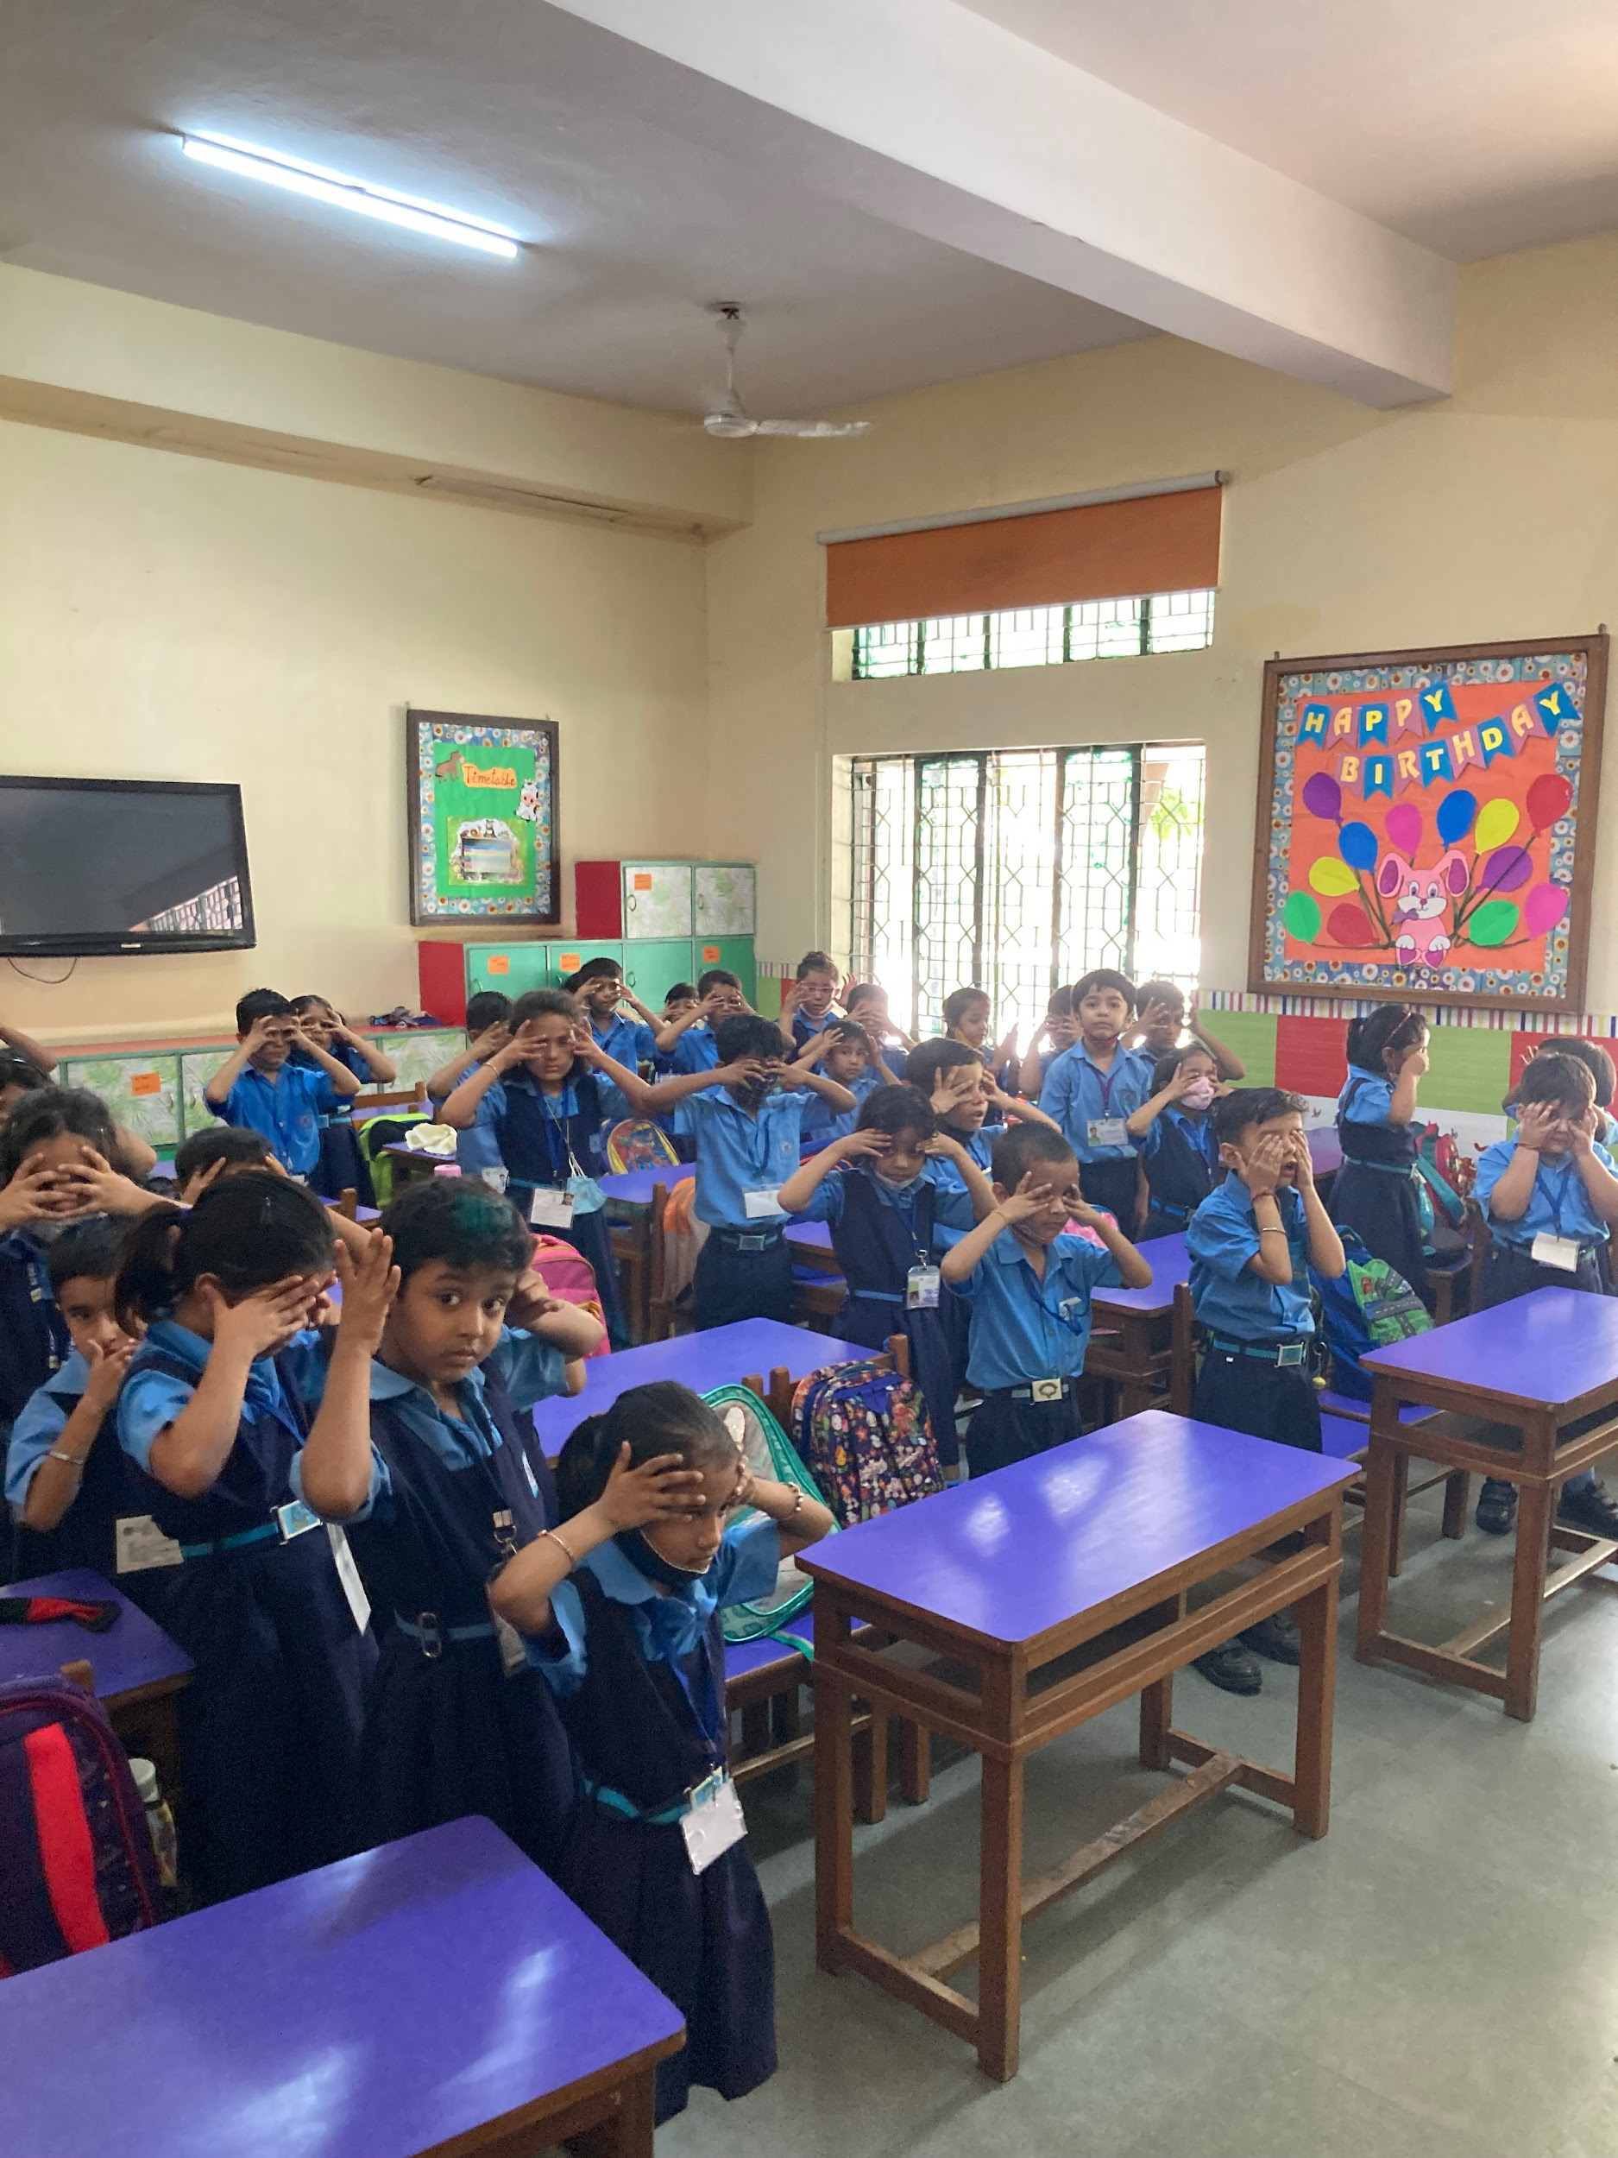
Delhi, India
School (Grades 1-12)
What are the children doing?
How does this reflect Globalization?
Where would you find this in the United States?
Notes:
Student guesses may include “Simon Says”; “Head, Shoulders, Knees and Toes.” Stretching, etc.,.
Point out that they are doing yoga, a practice from HInduism. This is done for 15 minutes every day.
Current issue in the US: Alabama ban on yoga in public schools (recently dropped.) An example of resistance to globalization/cultural conflict as a response to globalization.

Slide 4
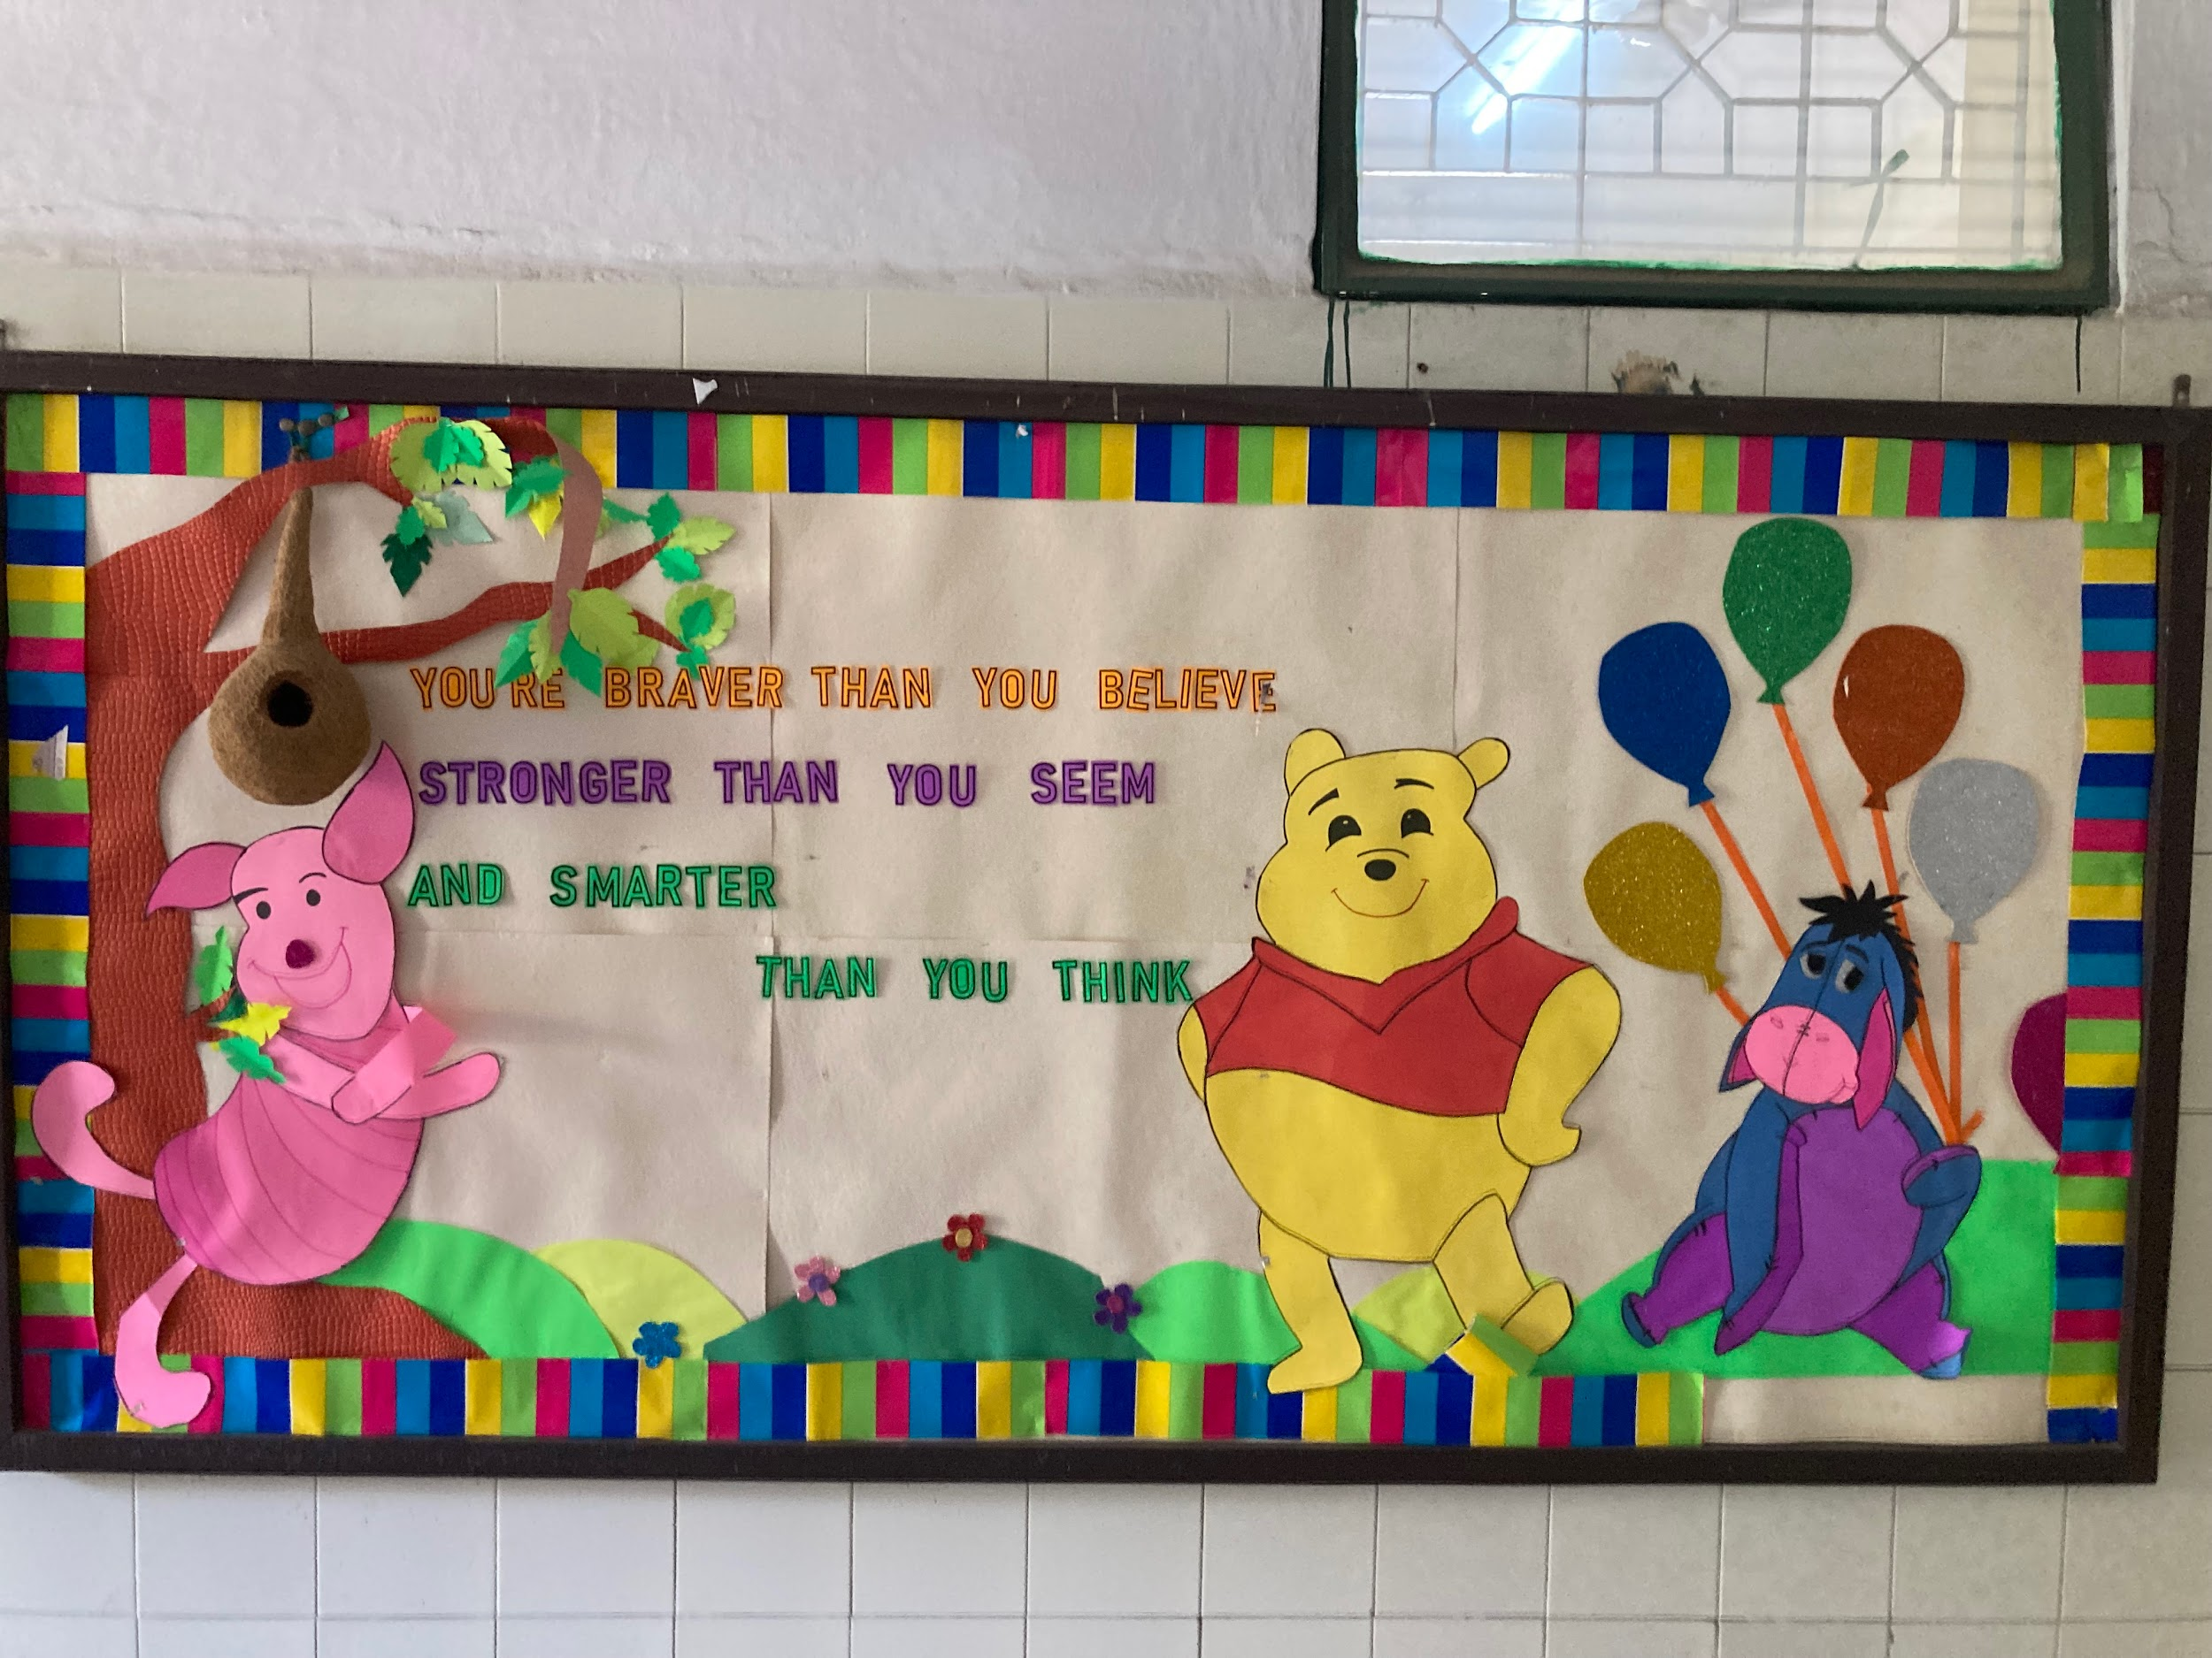
Where is Winnie? Guess where you may see this.
Notes:
Reveal to students that this, too, is from a school in Delhi India.
How does this reflect globalization? (English, Winnie the Poo)
Why is English spoken in India? (colonialism by the British, a process which facilitated Globalization) Review/connect to world history briefly.

Slide 5
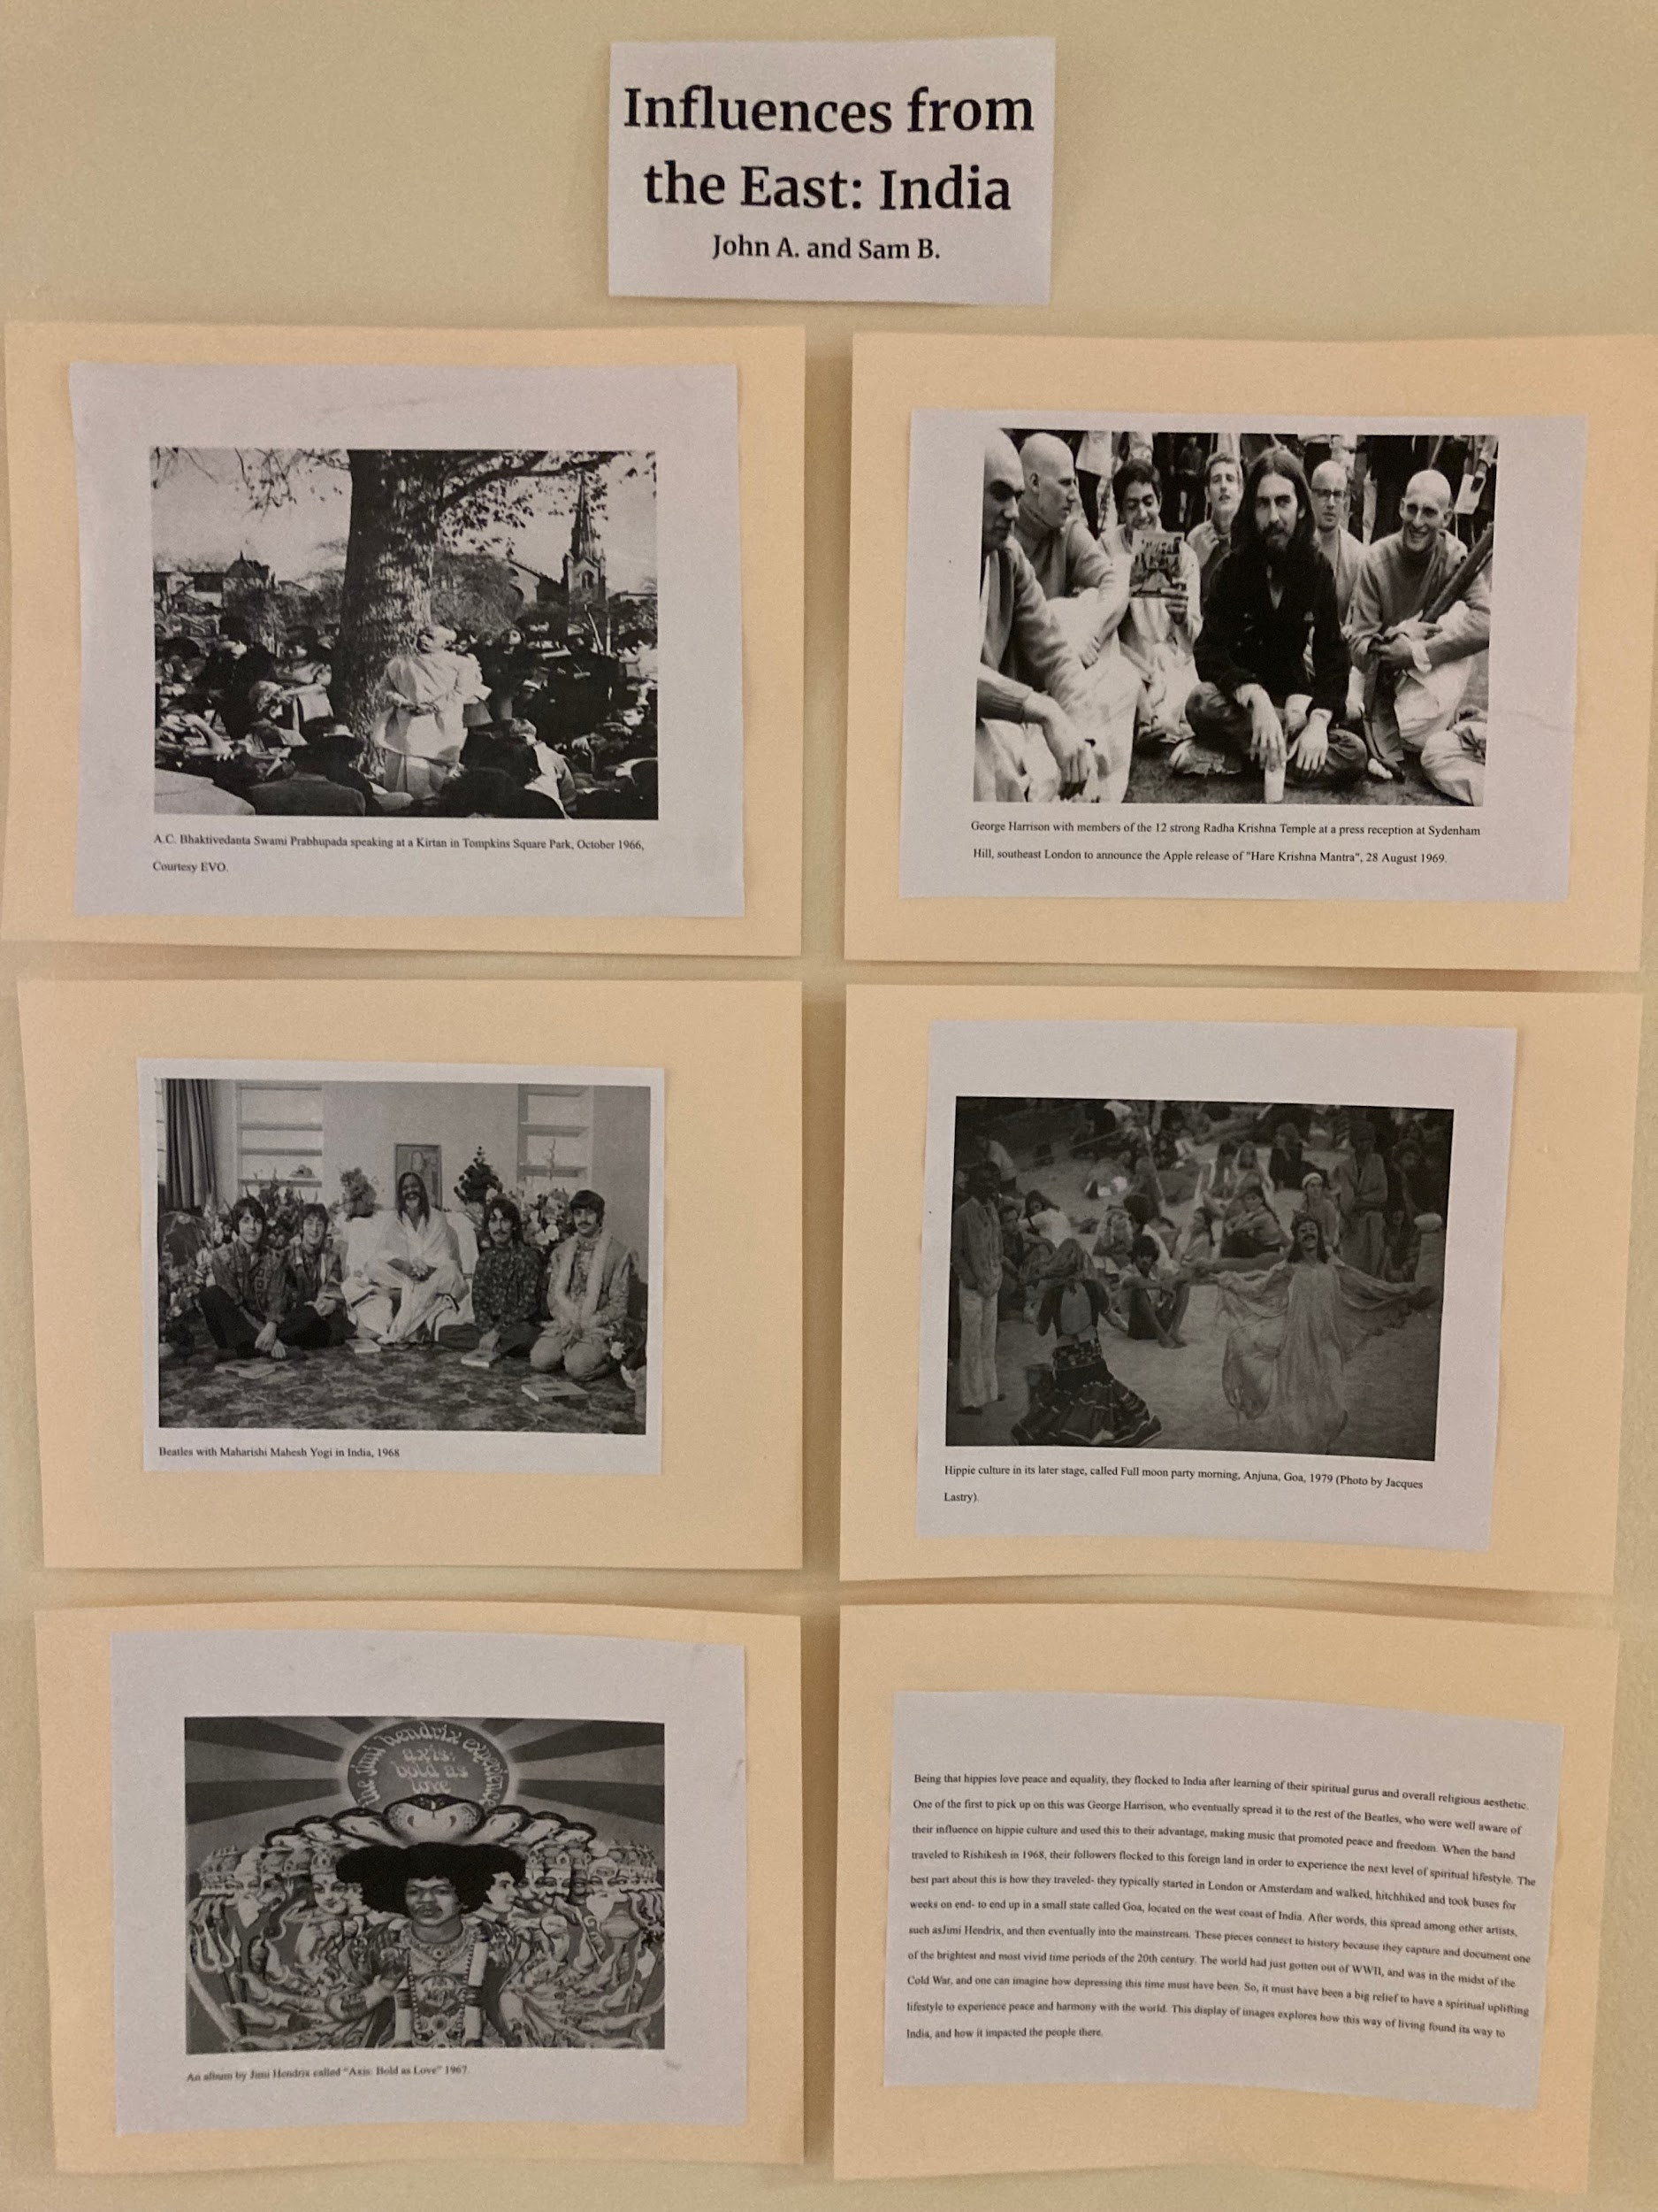
1960’s Hippie Movement
Connections to US History II
In what ways did 1960s popular culture in the United States draw from Indian culture?
Notes:
Displayed is an art exhibit assembled by students in US II showing how India influenced the hippie movement and music in the 1960s. Ask students to list examples of Indian culture that have been adopted in the US
Responses may include: Yoga, meditation, Buddhism, Hinduism, gurus, “chakras” and “energy healing” as alternative spirituality/medicine (ALL part of US culture today!!!) Ayurvedic medicine, tea.
(I showed them a box of my Yogi Tea with yoga tips on it)

Slide 6
Music: Global Connections
Listen to “Satyagrah” by Philip Glass
1970s Opera composed and sung in Sanskrit.
https://www.youtube.com/watch?v=PCGmbzRz9Ws
“Om” by John Coltrane, 1965.
https://www.youtube.com/watch?v=GwrV0qCX1LU
Listen to both selections. In what ways do these music pieces reflect the spread and mixing of global cultures?
Notes:
Both can be found in Spotify and played from speakers or use the youtube.com links

Slide 7
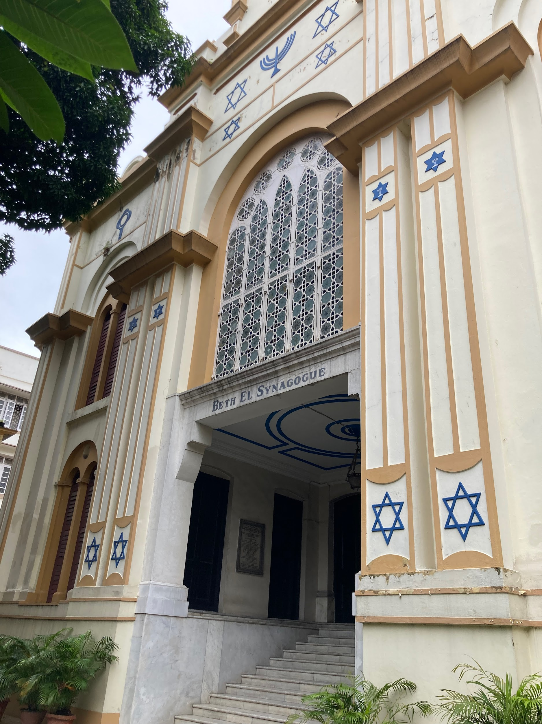
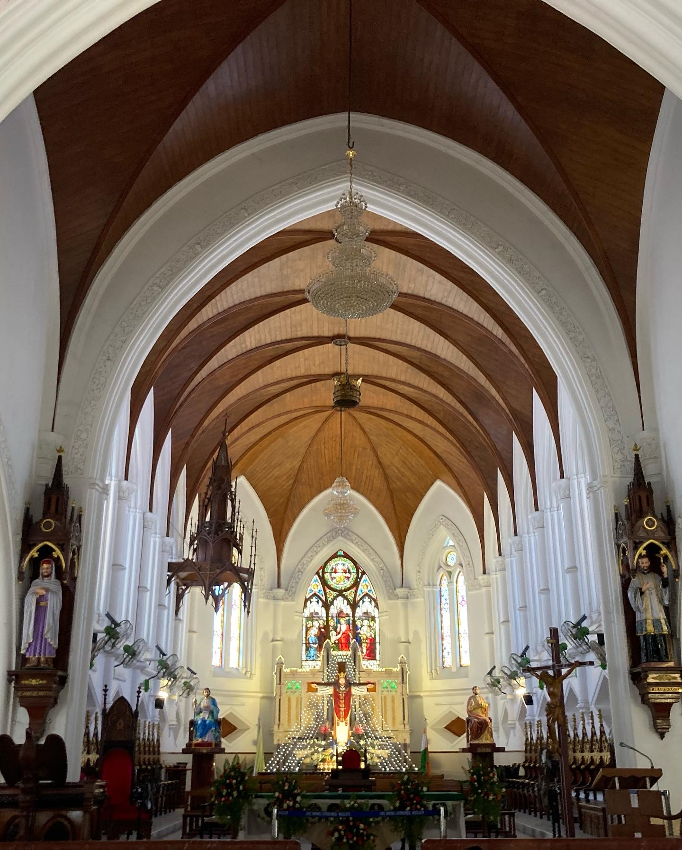
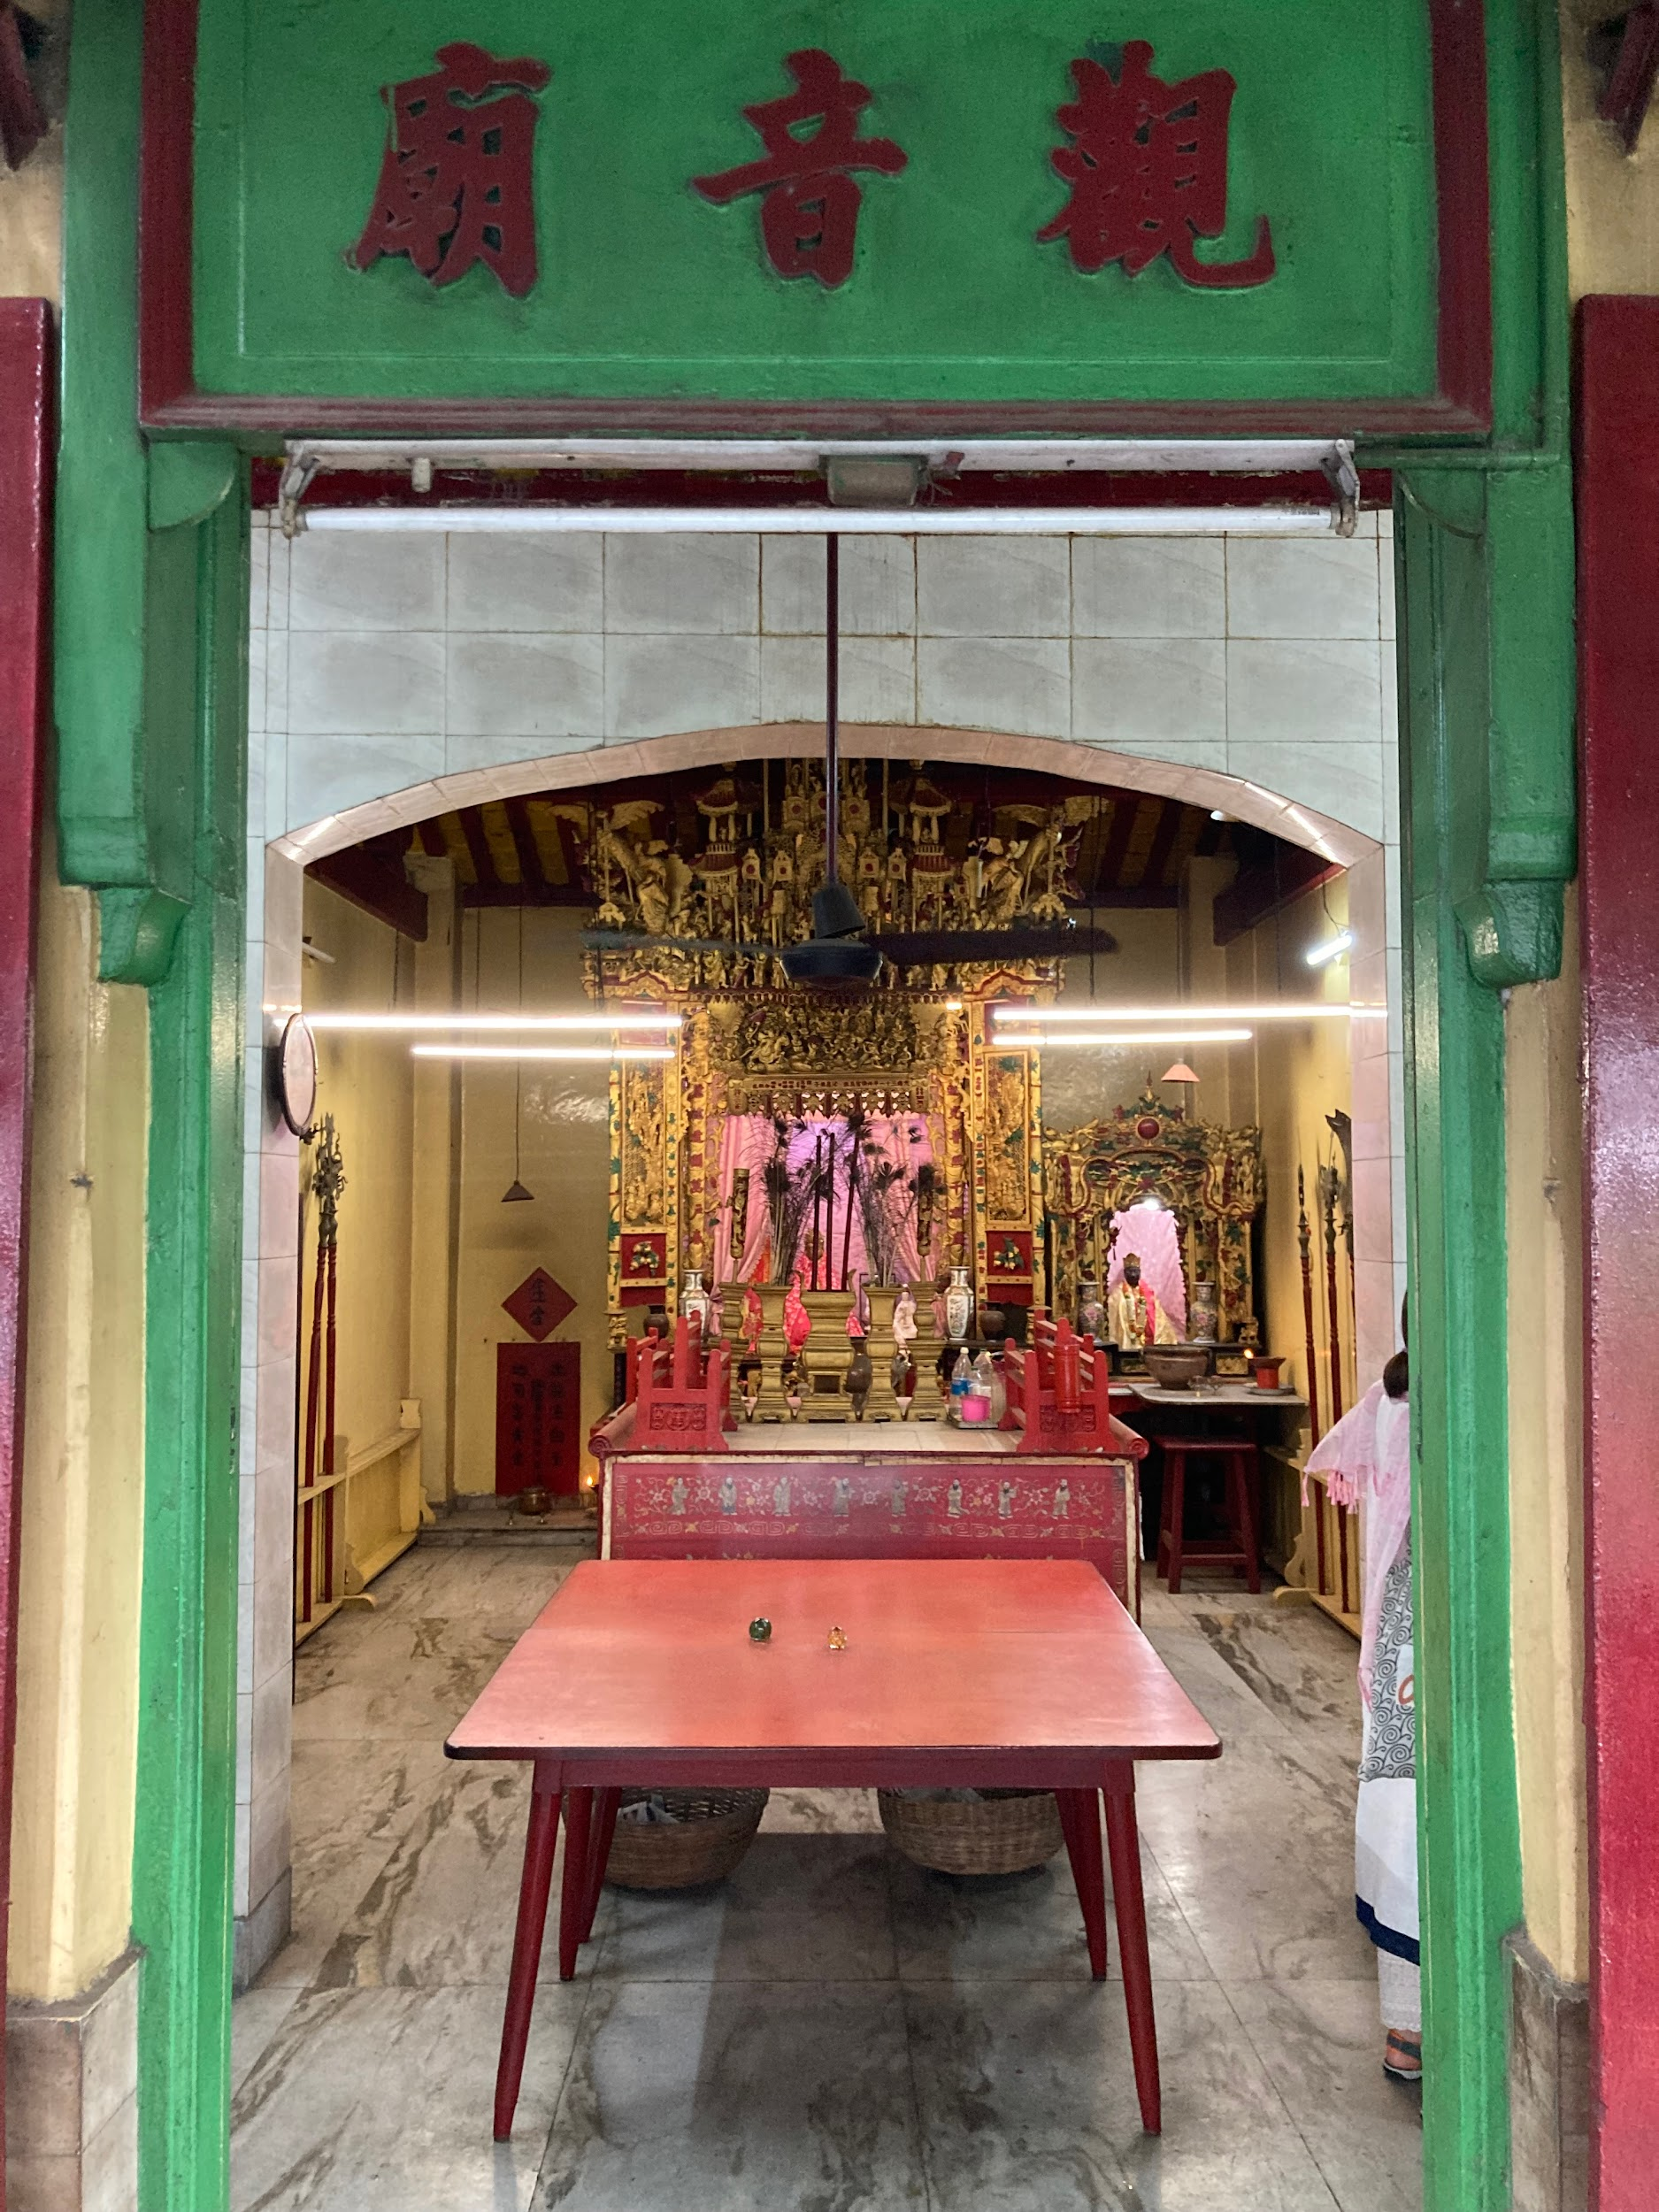
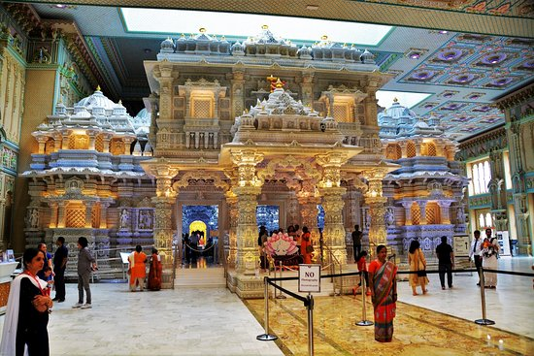
Where in the world?! ID each and guess where in the world they may be located.
Notes:
Have students guess where each may be and ask them what in picture supports their guess.
Reveal to them that all but the last one is in India. Students will likely react with surprise.
Key: See slide show. (Note: All the pictures in here were taken by me)

Slide 8
What do you know about India today?
(Religion,history, language, economy, government…)
List what you brainstorm:
Notes:
Ask students to brainstorm everything they know about India. For the tech-savy among us there are ways to do this from student phones. I use the chalk board :)

Slide 9
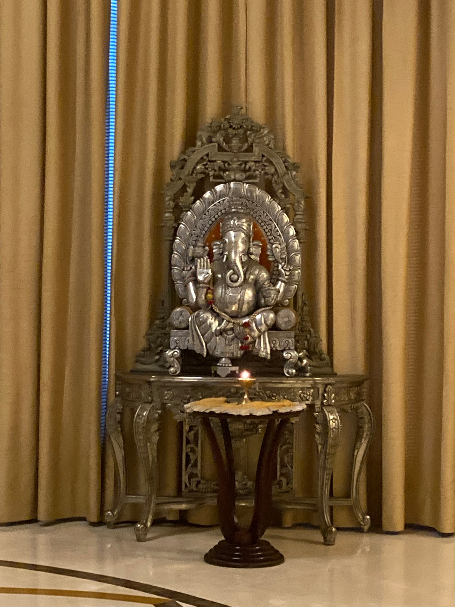
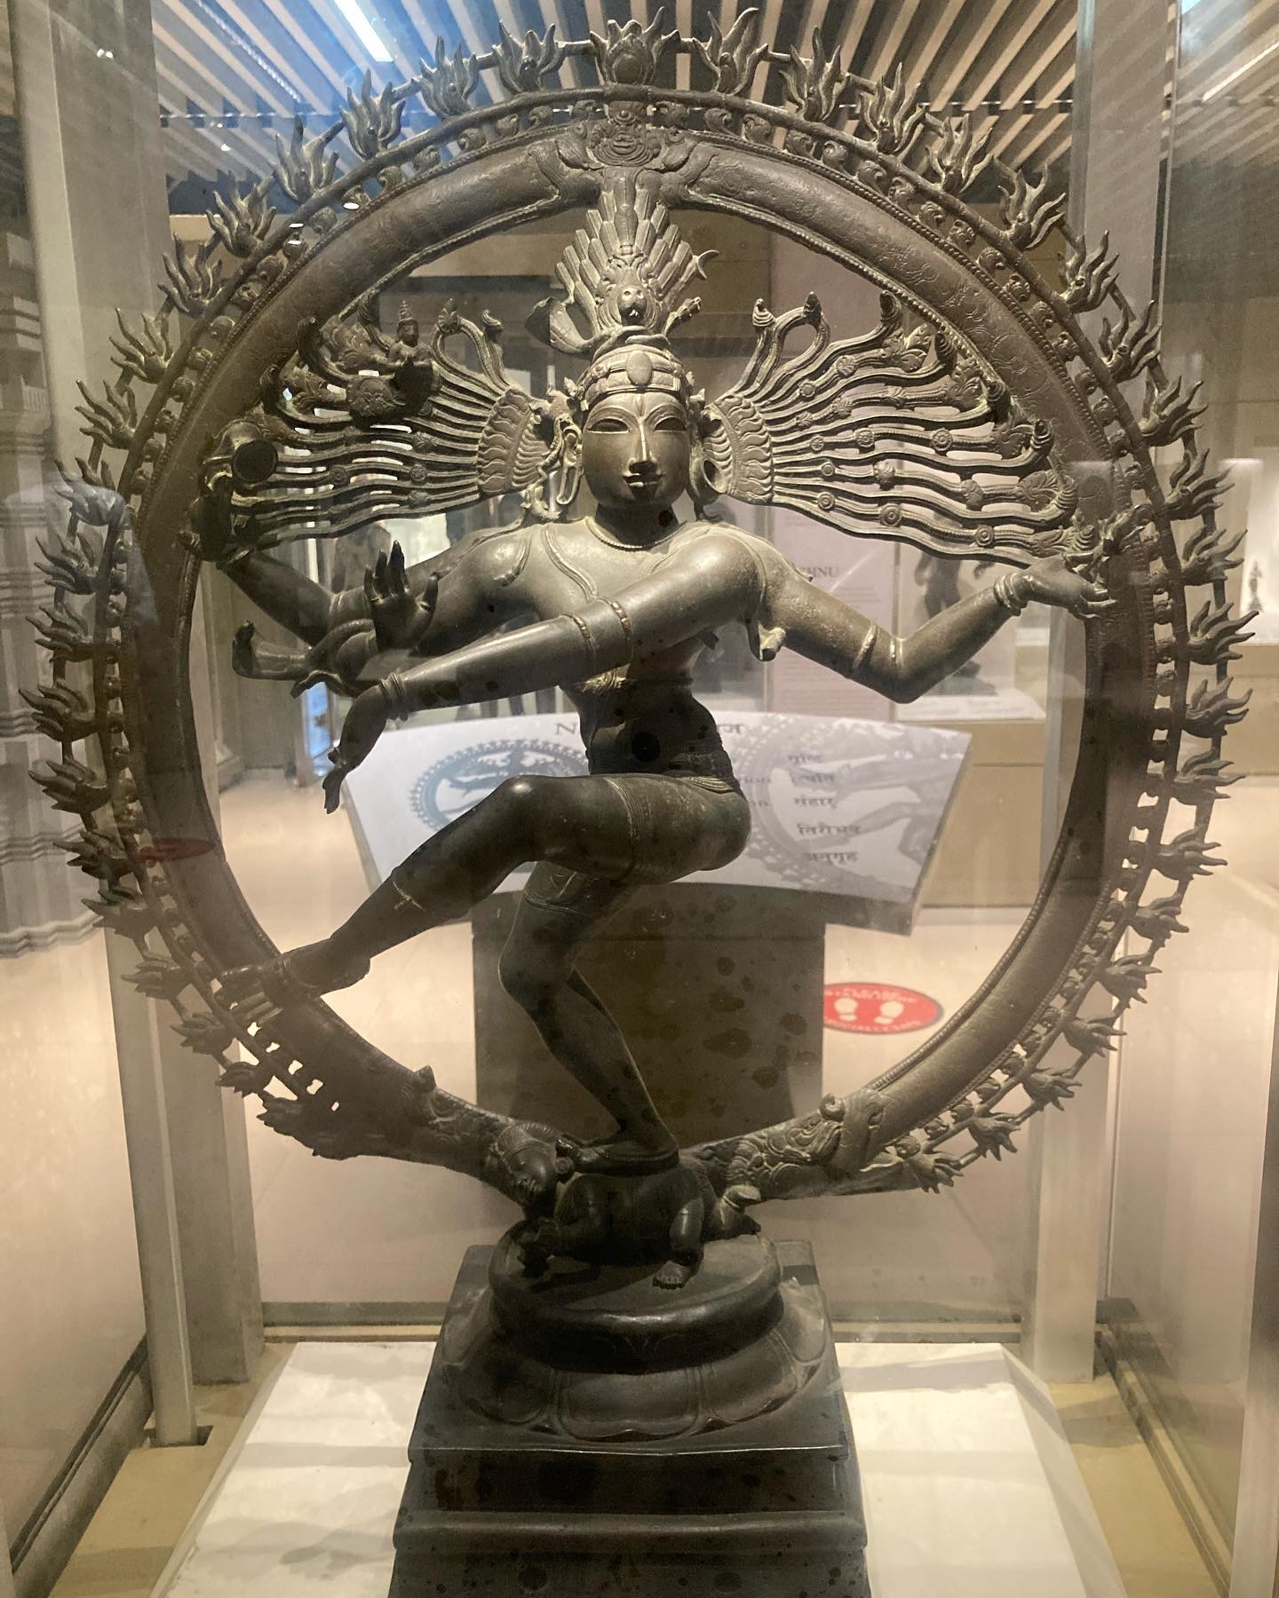
Hinduism: Ganesha and Natarajah
Notes:
Ask students if they know who Ganesha or Natarajah are. Talk about Hinduism as a henotheirstic faith and review/connect to what they learned in World History.

Slide 10
Group Mini-Research on Religions in India
Each group will be assigned to research ONE of the following religious sites in India. You should look up and be prepared to present:
Short overview of the religion. What are 2-3 main beliefs?
History of the religious community and their place of worship. When and why did they come to India? When was their place of worship constructed?
How does this religious community reflect the process of globalization? Cultural mixing?
Notes:
This will focus on religion. Instructor can customize and include a map of different languages, ethnic groups, foods in India.

Slide 11
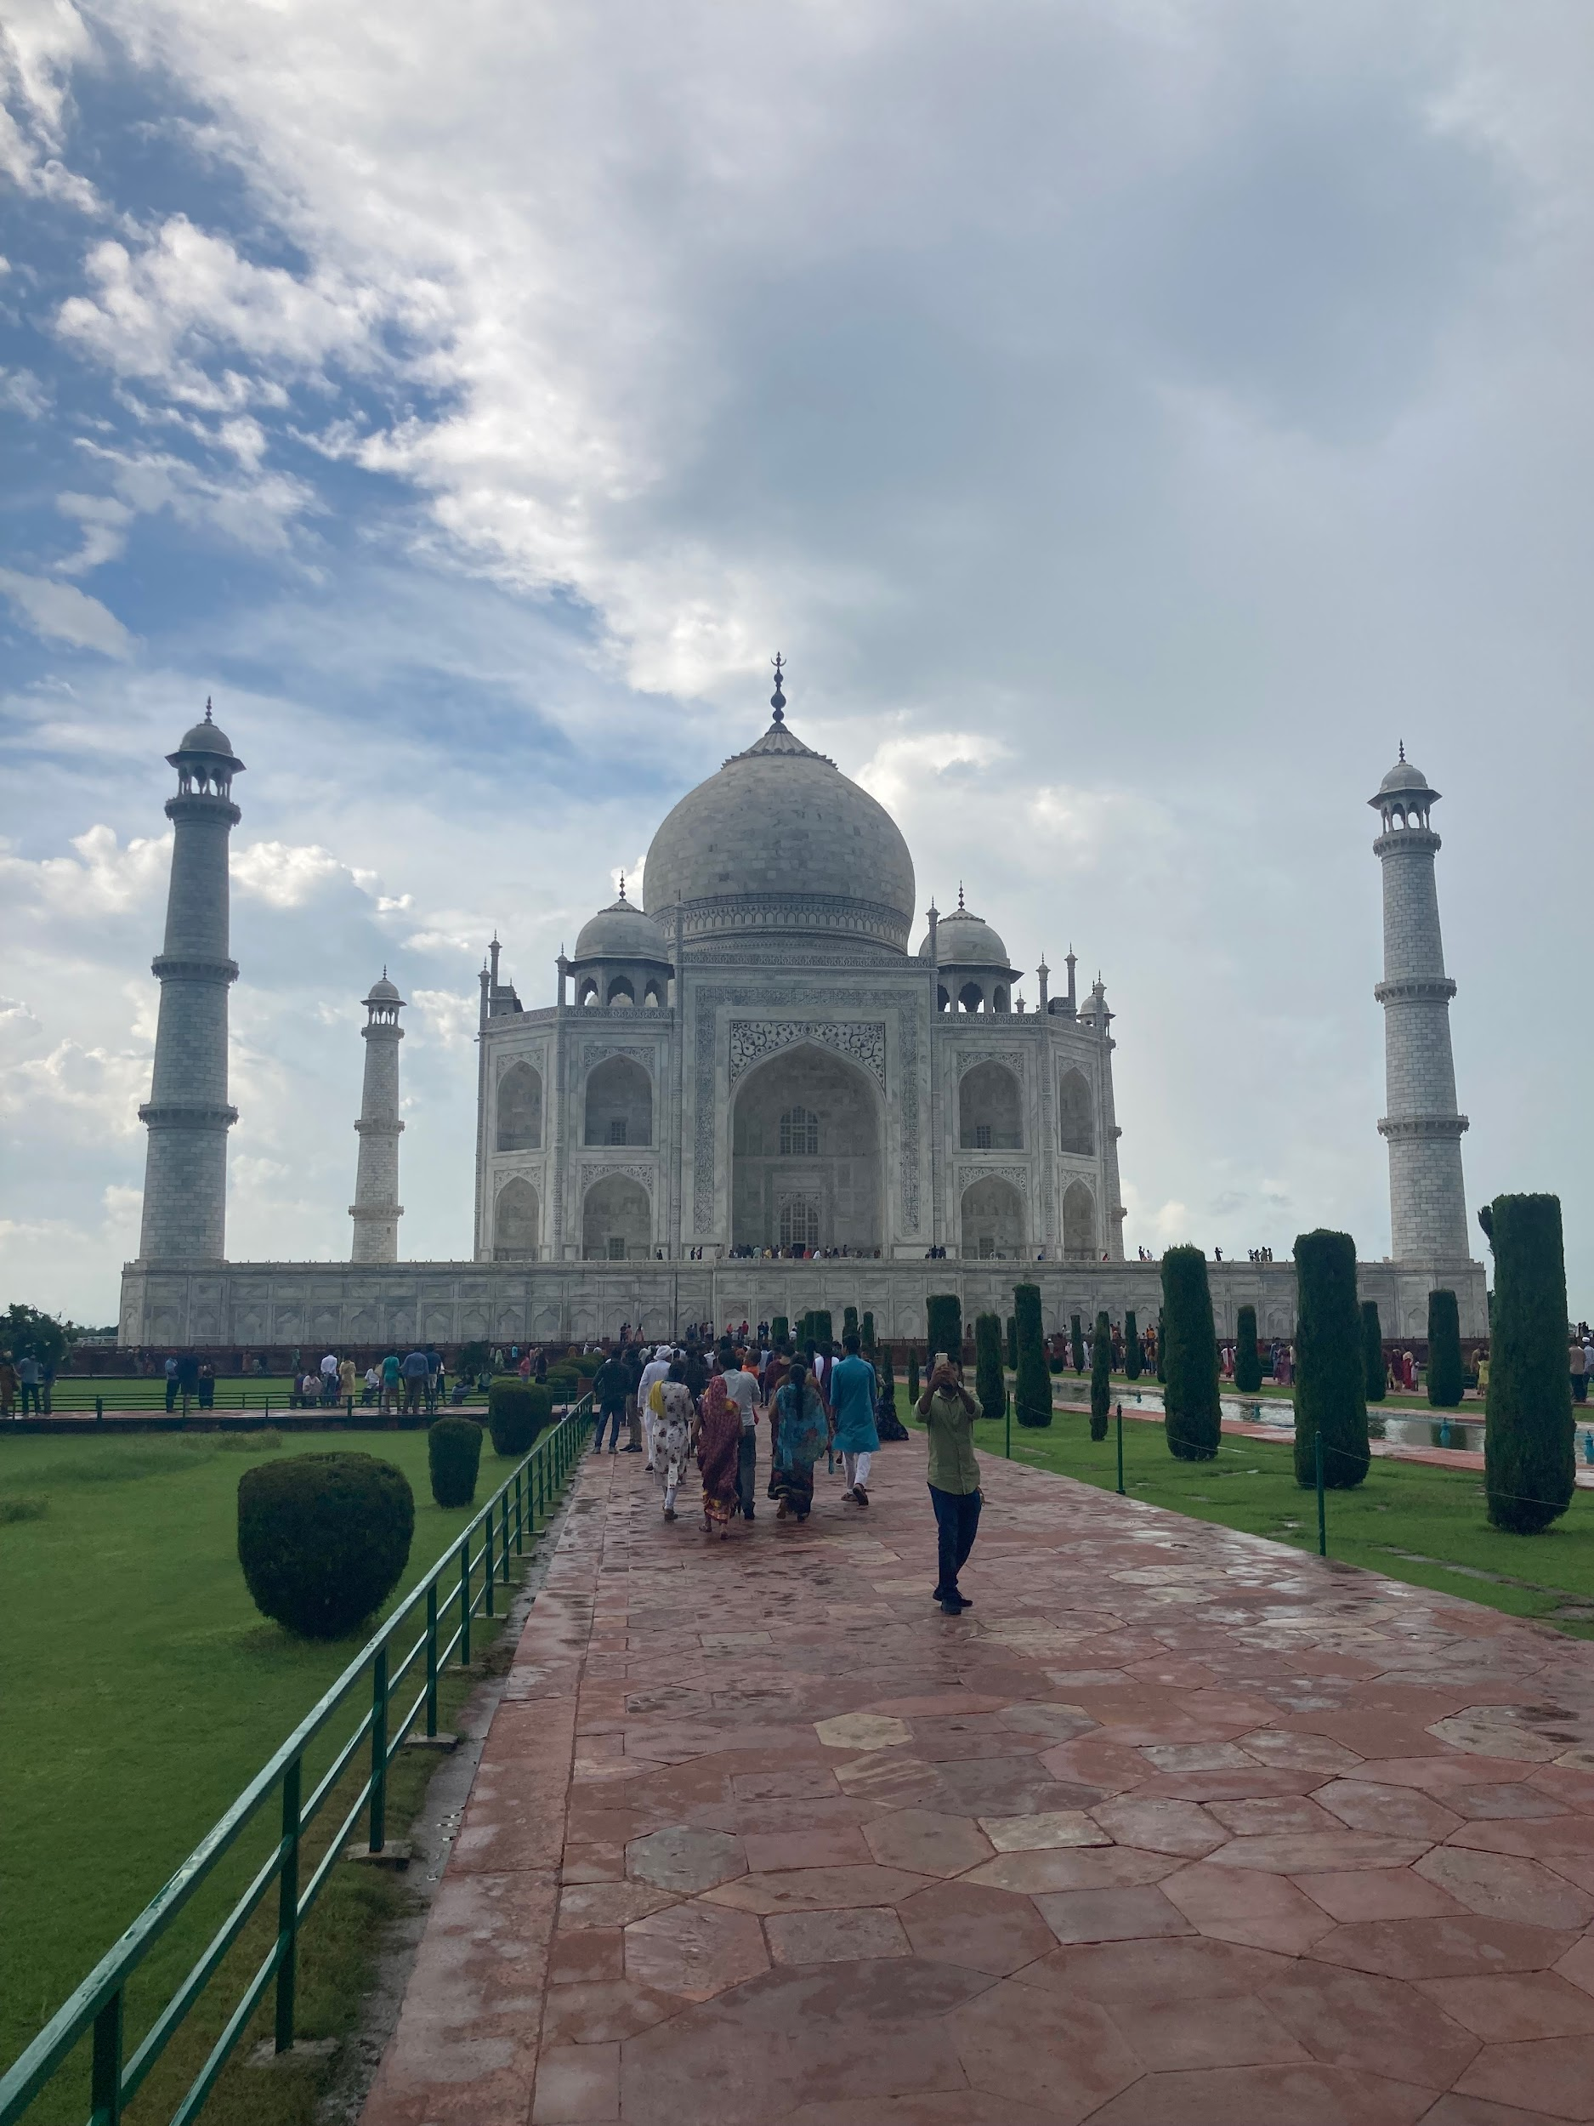
Taj Mahal of Shah Jahan
Syncretic architecture
Notes:
The text in slides 13-19 is intentionally blank. Students were assigned one of the buildings to research with their table mates and then briefly presented the information. Depending on the level of the class, the instructor can simply discuss this OR use the blank space in the slides to take bullet-style notes on a Smartboard or as a handout.

Slide 12
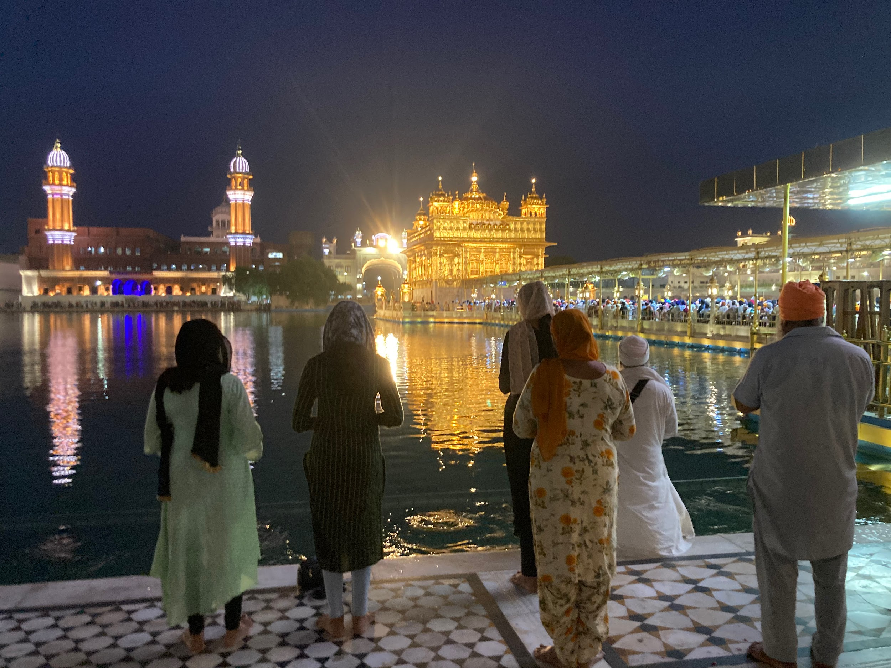
2. Golden Temple,
Sikh faith

Slide 13
3. Indian Chinese Association, Bengal

Slide 14
4. St. Thomas Church, Chennai

Slide 15
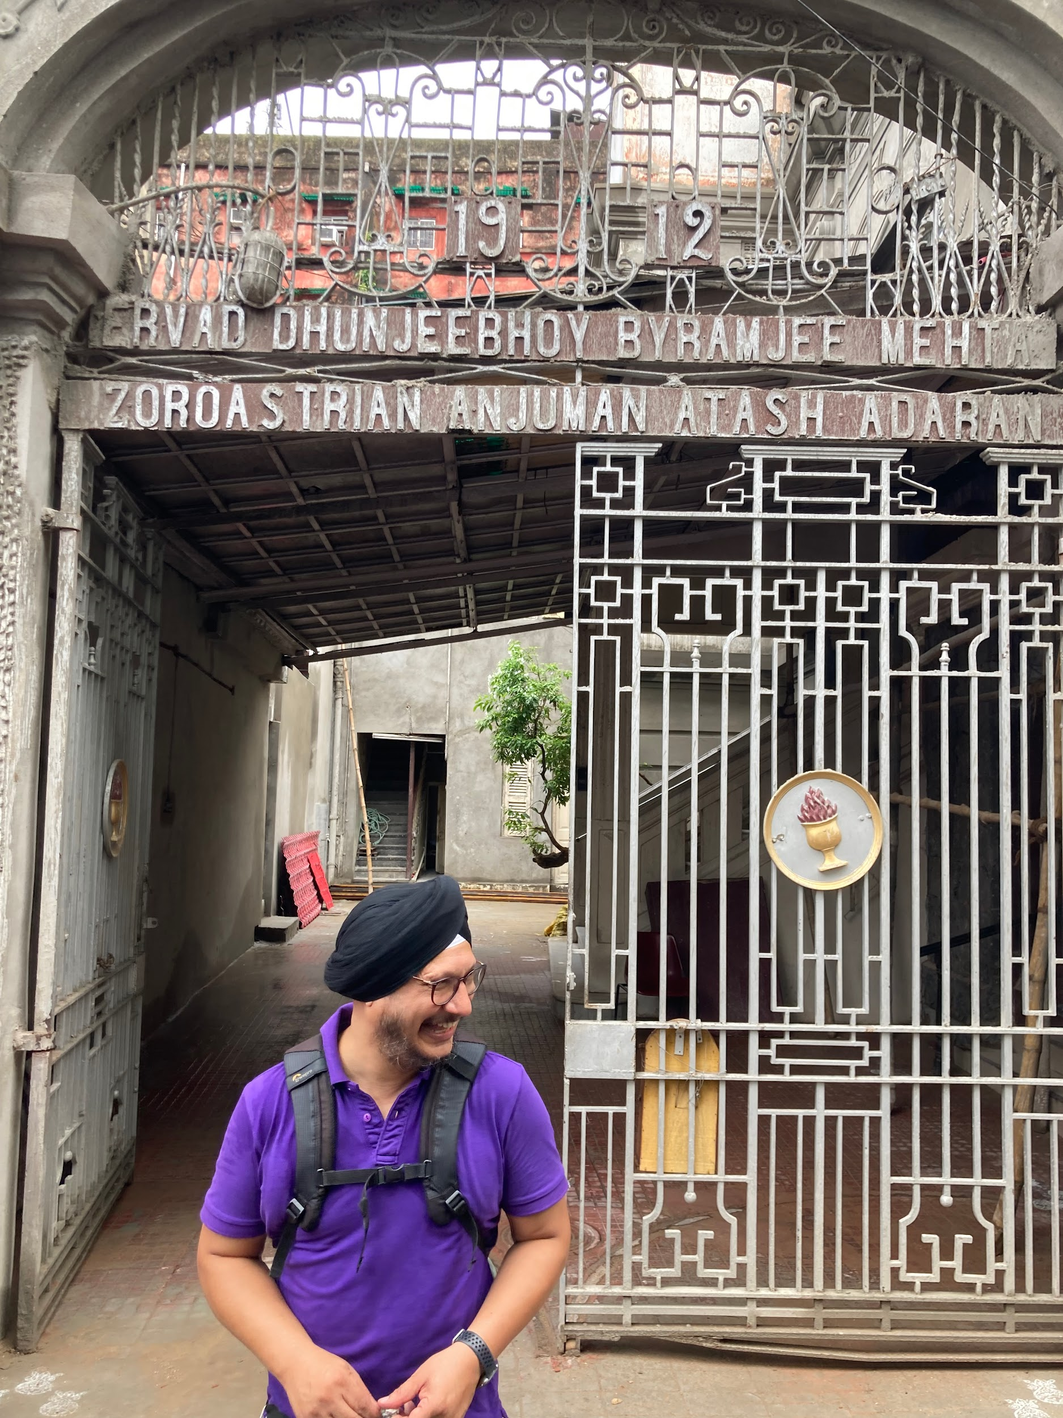
5. Parsi Zoroastrian Temple, Kolkata

Slide 16
6. Jewish Temple, Kolkata

Slide 17
7. Hindu Temple, Robinnesville, NJ

Slide 18
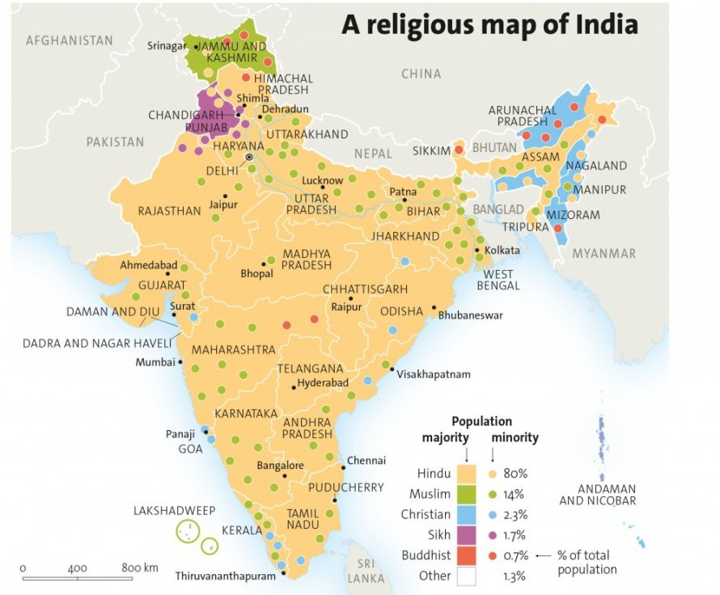
Reflect on what you learned by responding to one of the following questions:
In what ways did the slide show of religions in India challenge your understanding of what you thought India was like?
How do the diverse religious traditions of India reflect the process of globalization?
Notes:
Map Source: https://mondediplo.com/maps/india-religion
I have student samples of these responses. Some were excellent

Slide 19
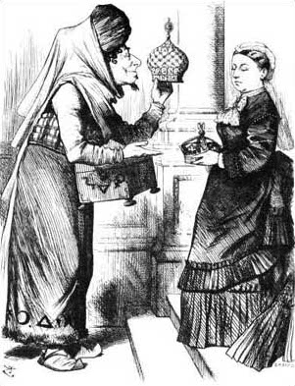
Current Issue: The Death of Elizabeth II and the Crown Jewels
Some people in India want their diamond back:
https://www.youtube.com/watch?v=eP0y5S3fK44
Notes:
Benjamin Disraeli Cartoon, 1876.
Connect the Colonization of India to Current Issues/death of Elizabeth II.
This came up in my CGI class when the lesson was delivered, so I added this in. Instructors can edit out or skip.

Slide 20
Student Response Samples Follow:
Notes:
I was proud that the responses were good quality and reflected student learning!

Slide 21
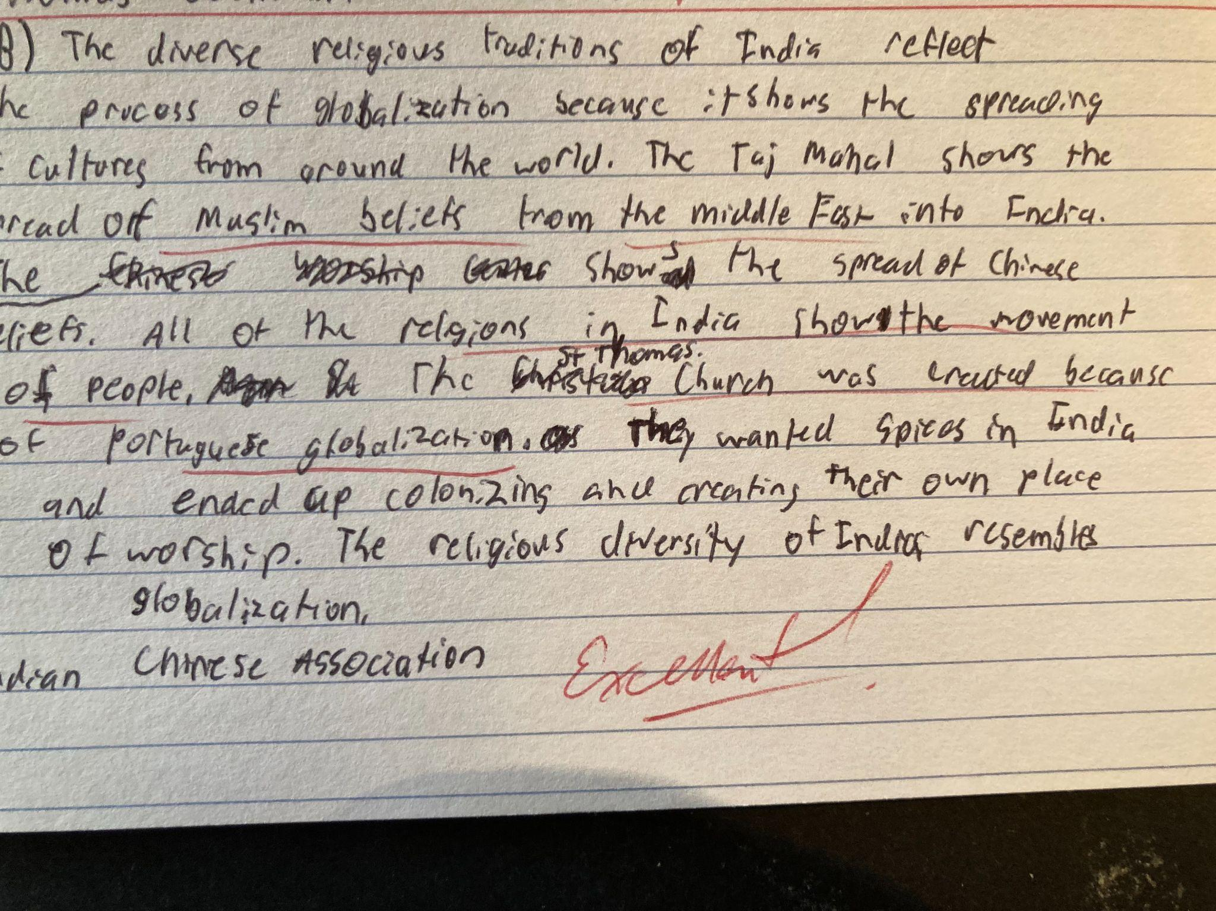
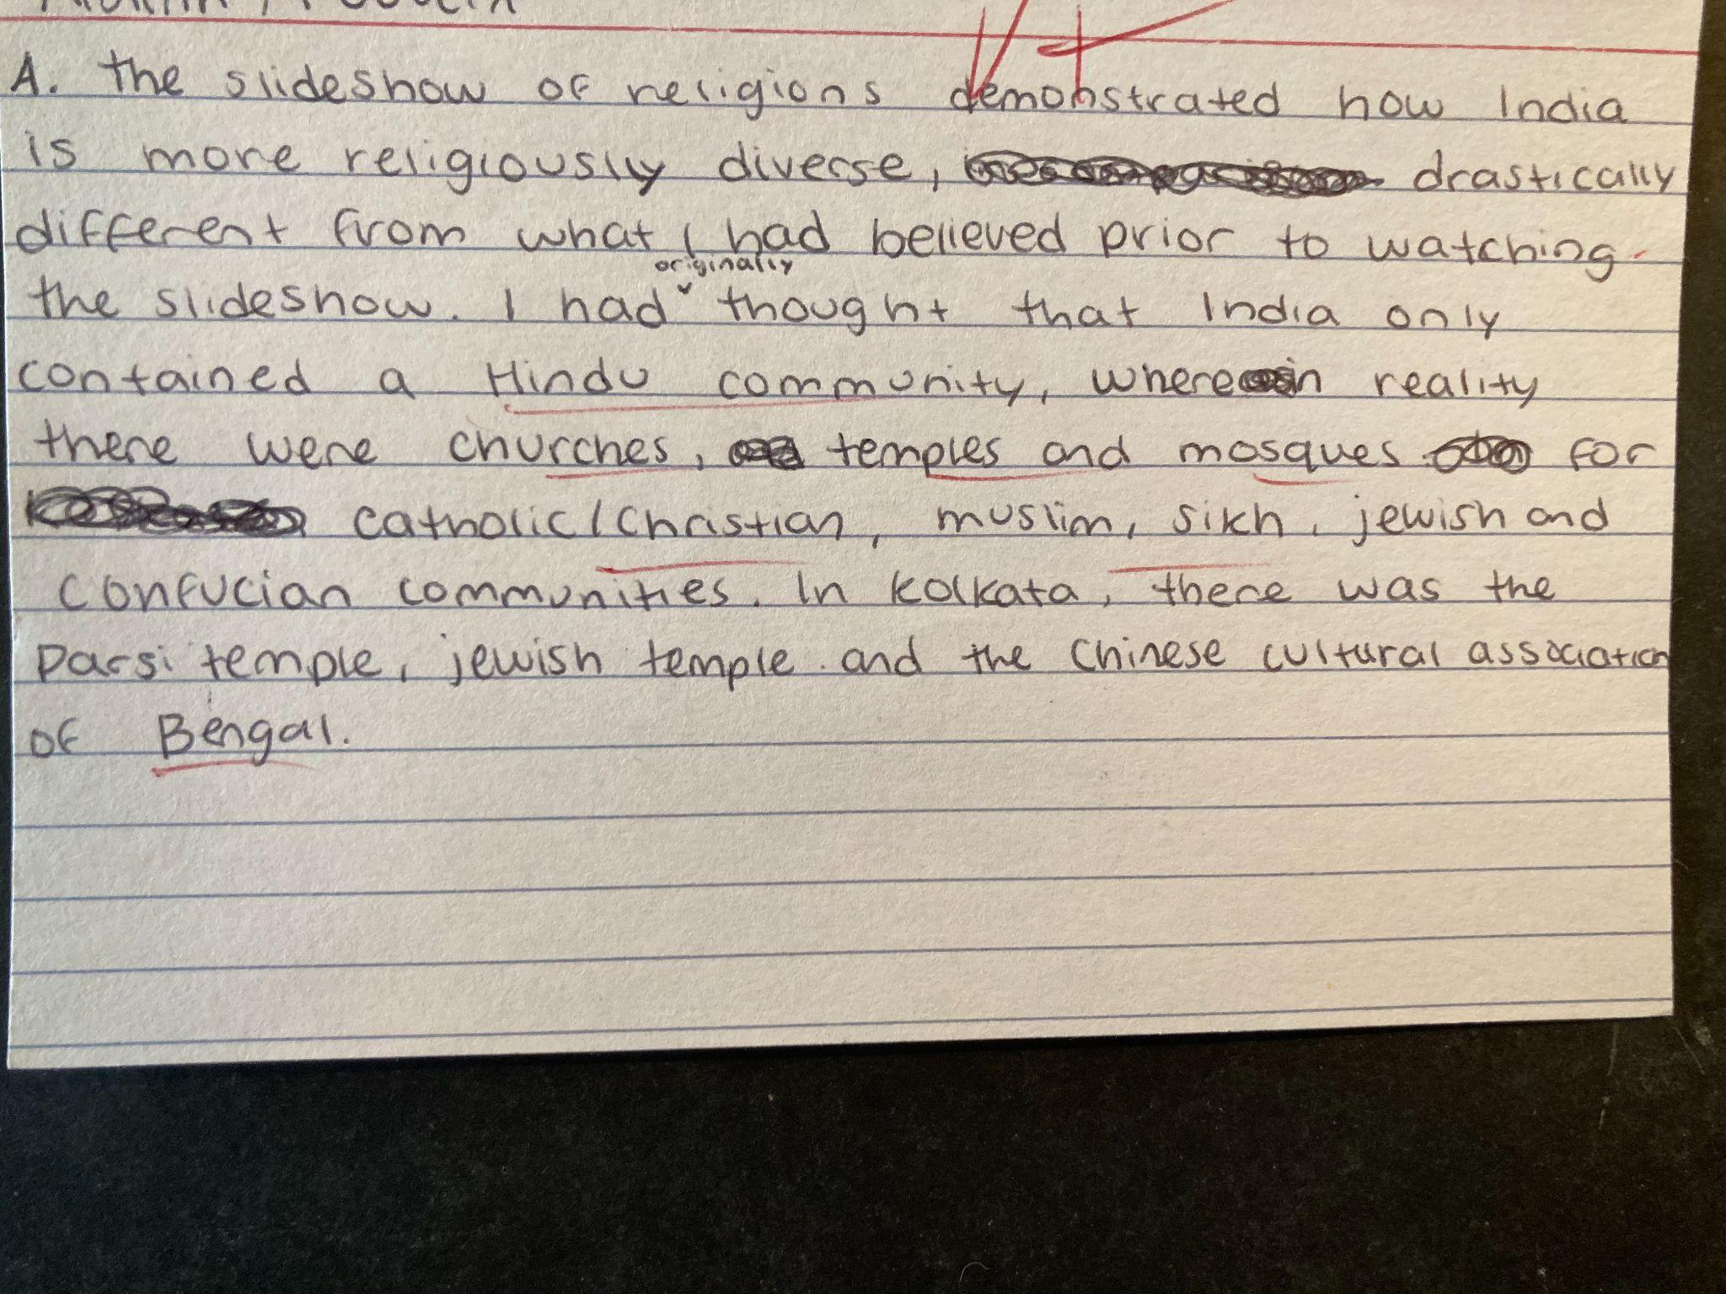
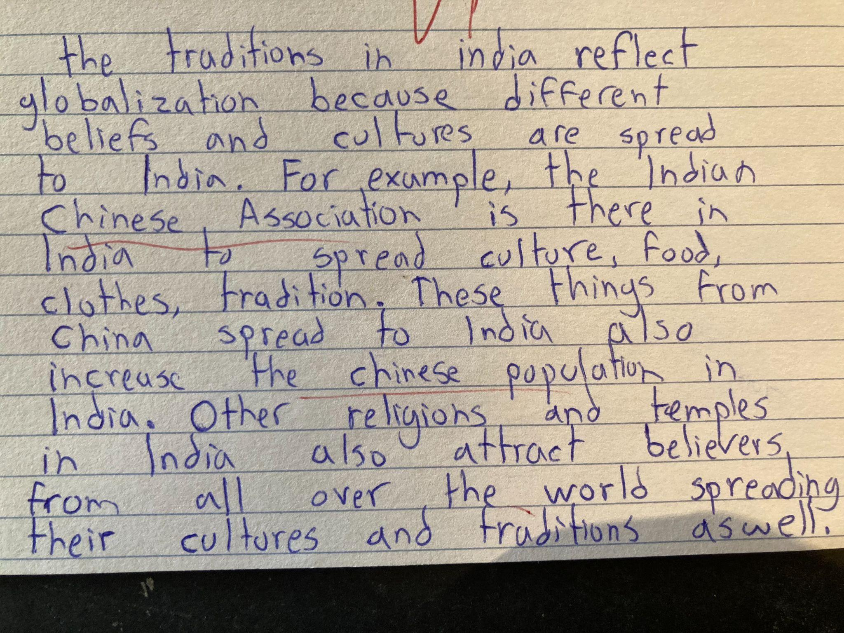
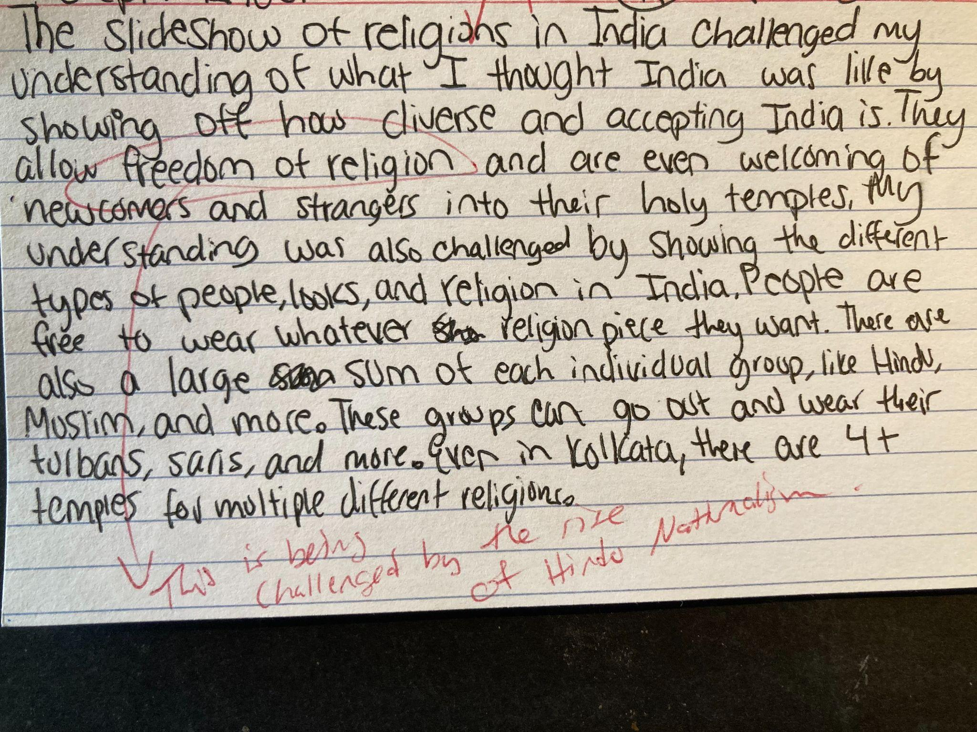
Notes:
Sample responses to questions in slide 19

